Slide 1
Sensitivity Analysis of Internal Erosion Models for Dam Safety
Mitchell Neilsen, Chendi Cao
Department of Computer Science
Kansas State University Manhattan, KS, USA
{ neilsen@ksu.edu, caocd@ksu.edu }
Notes:
This project involves the development of simulation environment that can be used to evaluate vegetated earth and rock spillways at the watershed scale. Key variables can be specified using probabilistic distributions, and samples for those variables can be generated using either Monte Carlo or Latin Hypercube Sampling. LHS requires fewer samples to achieve the same level of precision.
This project involves a collaborative research effort between KSU, the USDA, and the US Army Corps of Engineers. Spillway erosion is simulated using a three phase erosion model. The first phase is vegetal cover failure, the second phase is concentrated flow erosion, and the third phase is headcut advance. The focus of this paper is on the software architecture. Other recent papers focus on the model and the theoretical basis for the model.

Slide 2
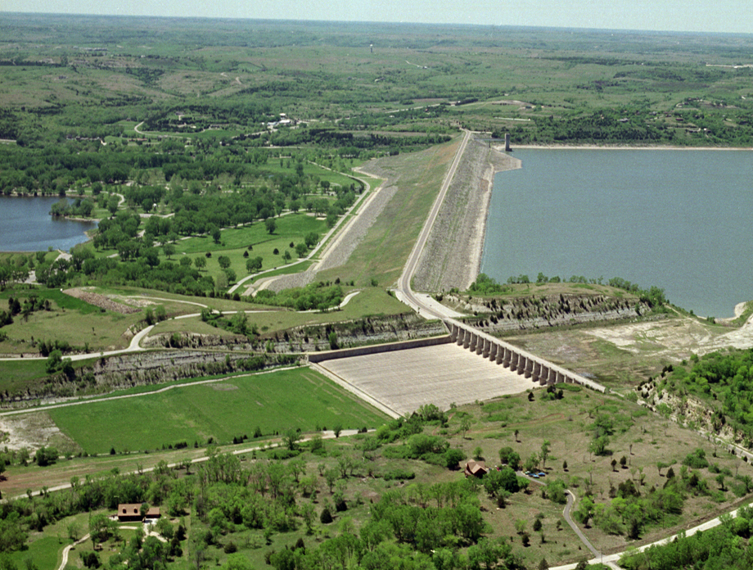

Tuttle Creek Reservoir Dam
Principal Spillway
Kansas
State
University
Dam
Auxiliary
Spillway

Slide 3

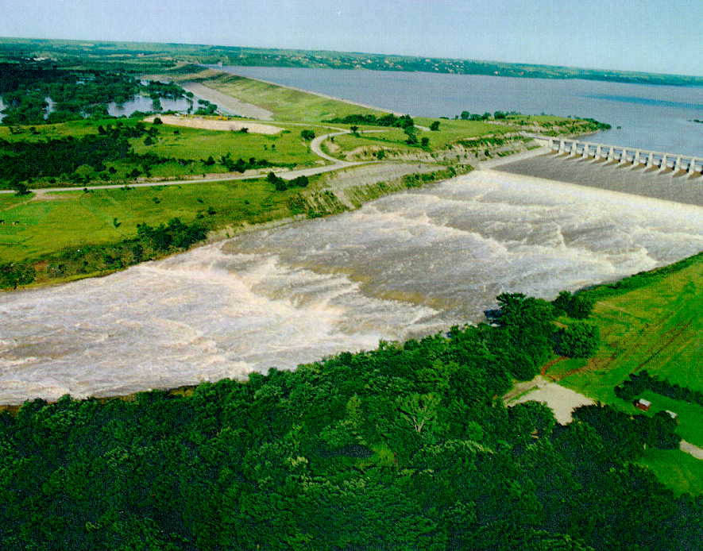
Auxiliary Spillway Discharge (1993)
Peak Flow: 60,000 cfs = 1,700 cms
Duration: 21 days
Notes:
18

Slide 4
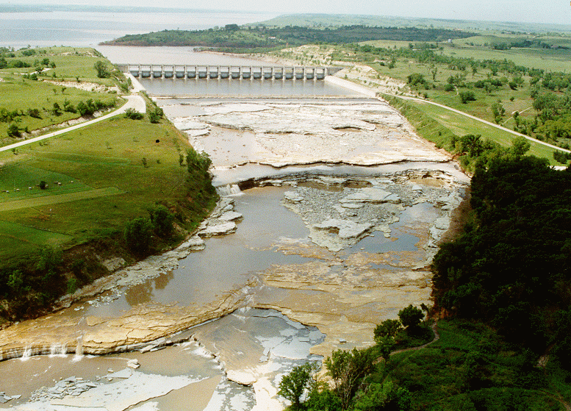
Spillway After 1993 Flood
Auxiliary Spillway Erosion (1993)
Erosion: 400,000 yd³
307,000 m³
Scarp Heights
up to 24 ft. (7 m.)
Notes:
20

Slide 5
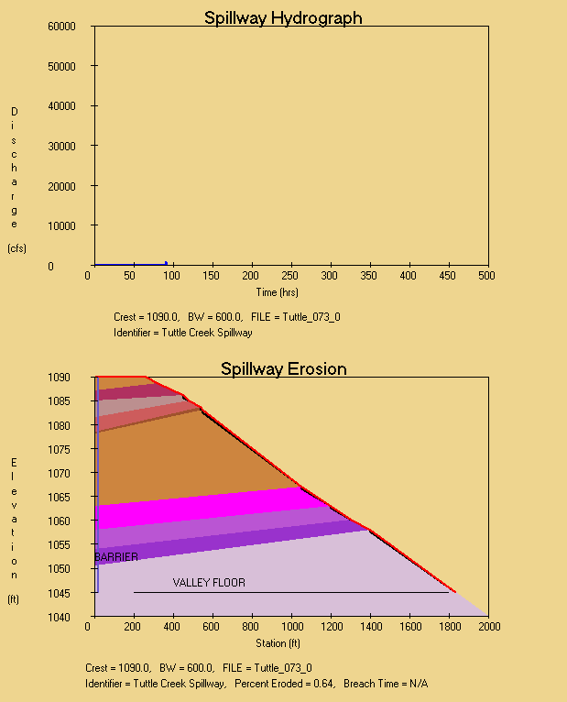
Example: Tuttle Creek Spillway

Slide 6
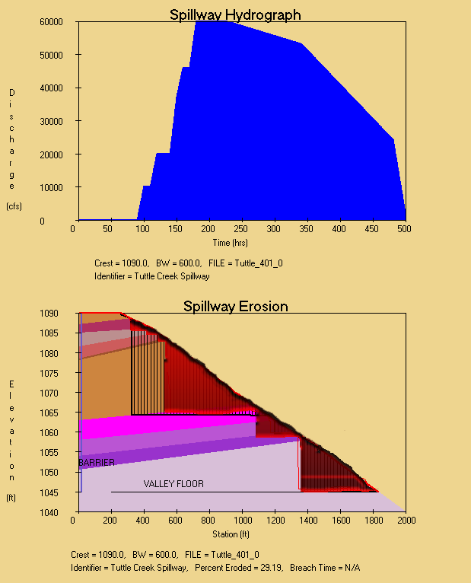
Example: Tuttle Creek Spillway
Actual Erosion

Slide 7
Causes of Dam Failures
Causes of Dam Failures* Percentage
Dam overtopping and auxiliary spillway failure 23 – 52%
Piping/seepage/internal erosion 25 – 44%
Slides 2 – 15%
Miscellaneous 9 – 40%
* V. Singh, “Dam breach modeling technology”, 1993.

Slide 8
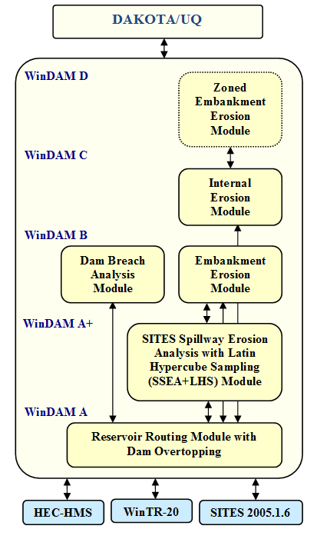
Windows* Dam Analysis Modules (WinDAM)
WinDAM is a modular framework for the design and analysis of water control structures (dams).
B
C
D
A+
Notes:
This paper describes the software components included in the integrated development environment, and a description of the flow of control and data through the environment. The software consists of four different componets, SitesSim is a module derived from Sites to compute the amount of erosion that occurs, an Integrity Checker to verify the syntactic correctness of the input data -- logical correctness is still up to the designer, although some warnings will be generated if some input parameters appear to be out of the normal range, DakotaLHS generates random samples based on the distribution specified by the user for a given variable, and finally the master application that controls overall data and control flow, interaction with the user, and parsing of input and output files to make them meaningful to the various components is the IDE SSEA.exe.

Slide 9
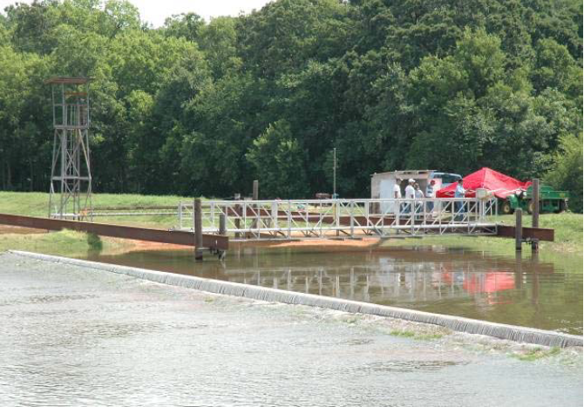
Weir Upstream of Test Embankment USDA Hydraulic Engineering Research Unit (HERU)

Slide 10
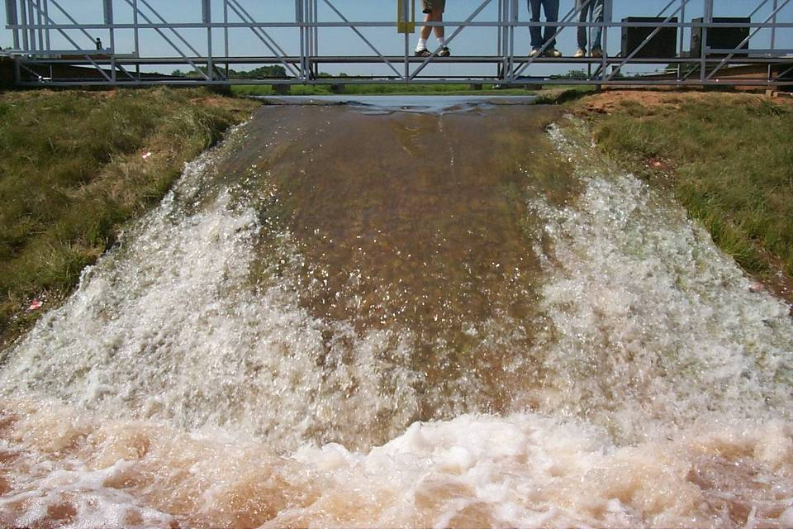
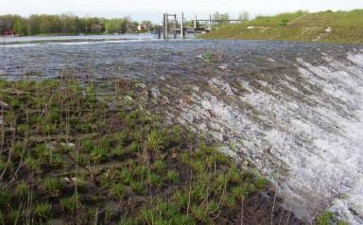
Dam Overtopping Breach Analysis

Slide 11
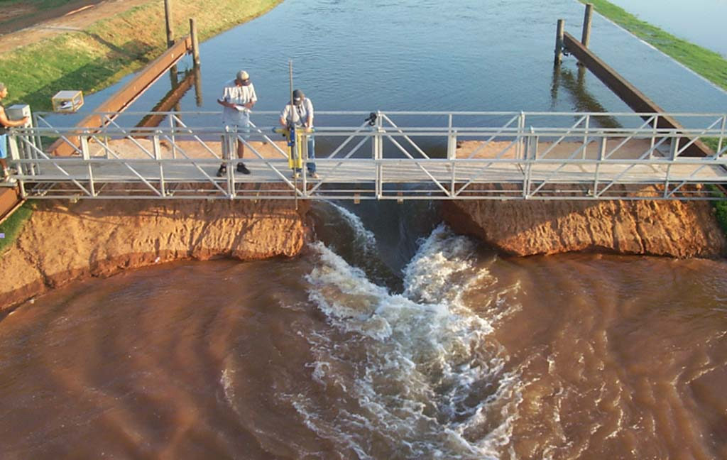
Dam Overtopping Breach Analysis

Slide 12
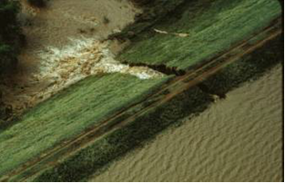
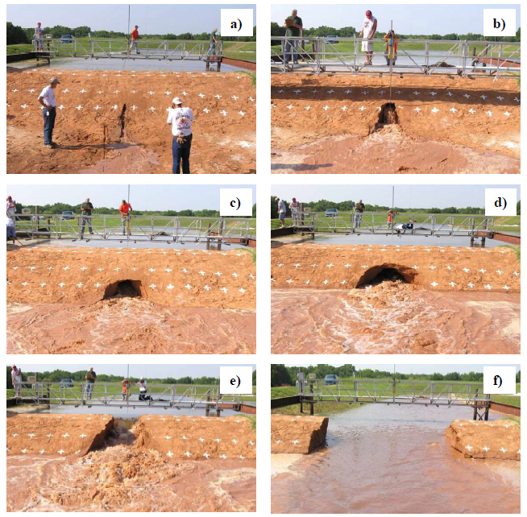
Internal Erosion Analysis (weak silty sand material - SM)
e) 13 min., f) 60 minutes.

Slide 13
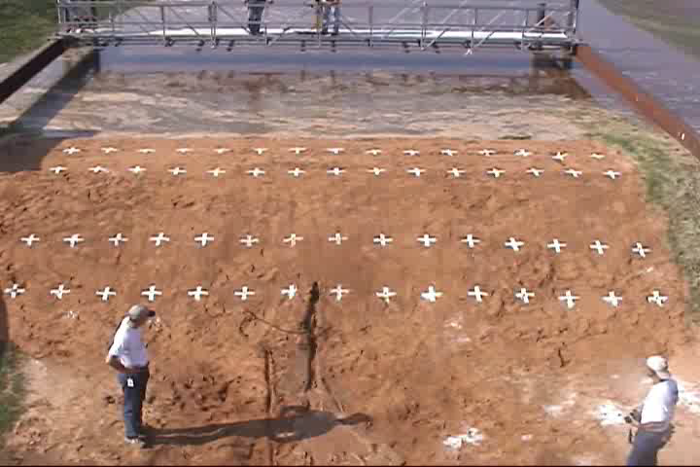
τ >> τ_{c} Rapid Internal Erosion
k_{d} ~ 57 (ft/hr)/psf
τ_{c} ~ 0 psf
OK ARS HERU

Slide 14
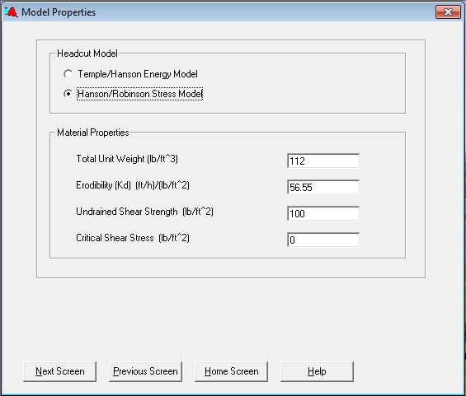
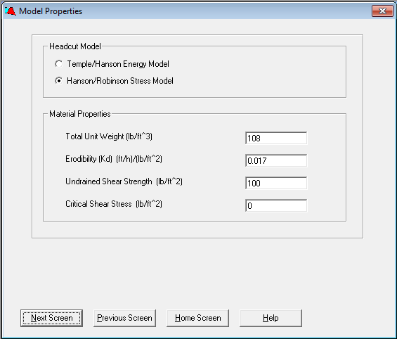
WinDAM Headcut Model Input
Silty sand (SM) material properties

Slide 15
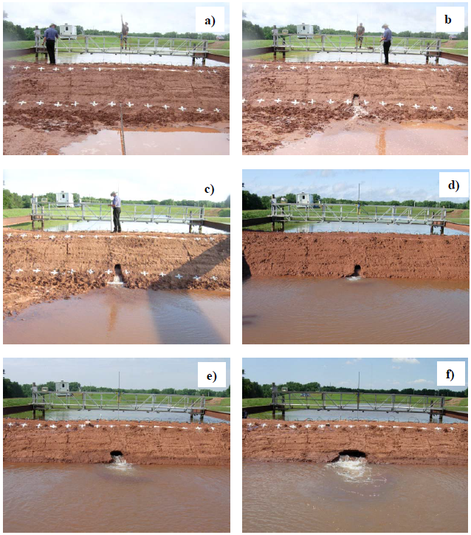
Internal Erosion Analysis (stronger clay material - CL)
e) 46 hours f) 72 hours.

Slide 16
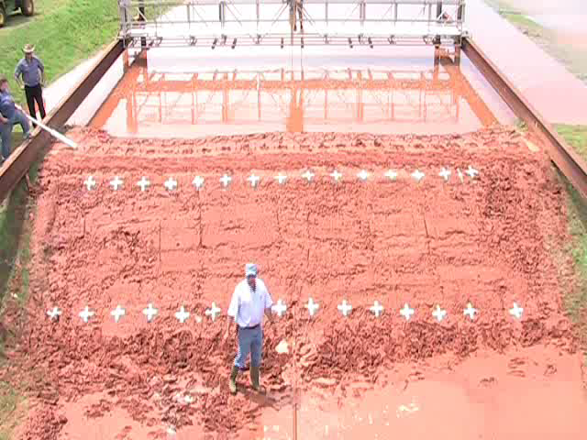
τ ~ τ_{c} Negligble Internal Erosion
k_{d} ~ 0.017 (ft/hr)/psf
τ_{c} ~ 0.0 psf
OK ARS HERU

Slide 17
WinDAM Headcut Model Input
Clay (CL) material properties

Slide 18
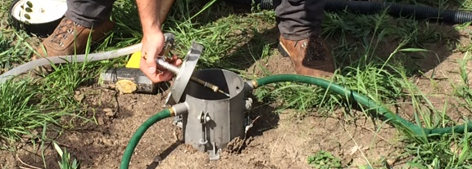
JET Field test for k_{d}
Submerged jet from known orifice diameter
Measured height above bare soil
Erosion is measured over time→ k_{d}

Slide 19
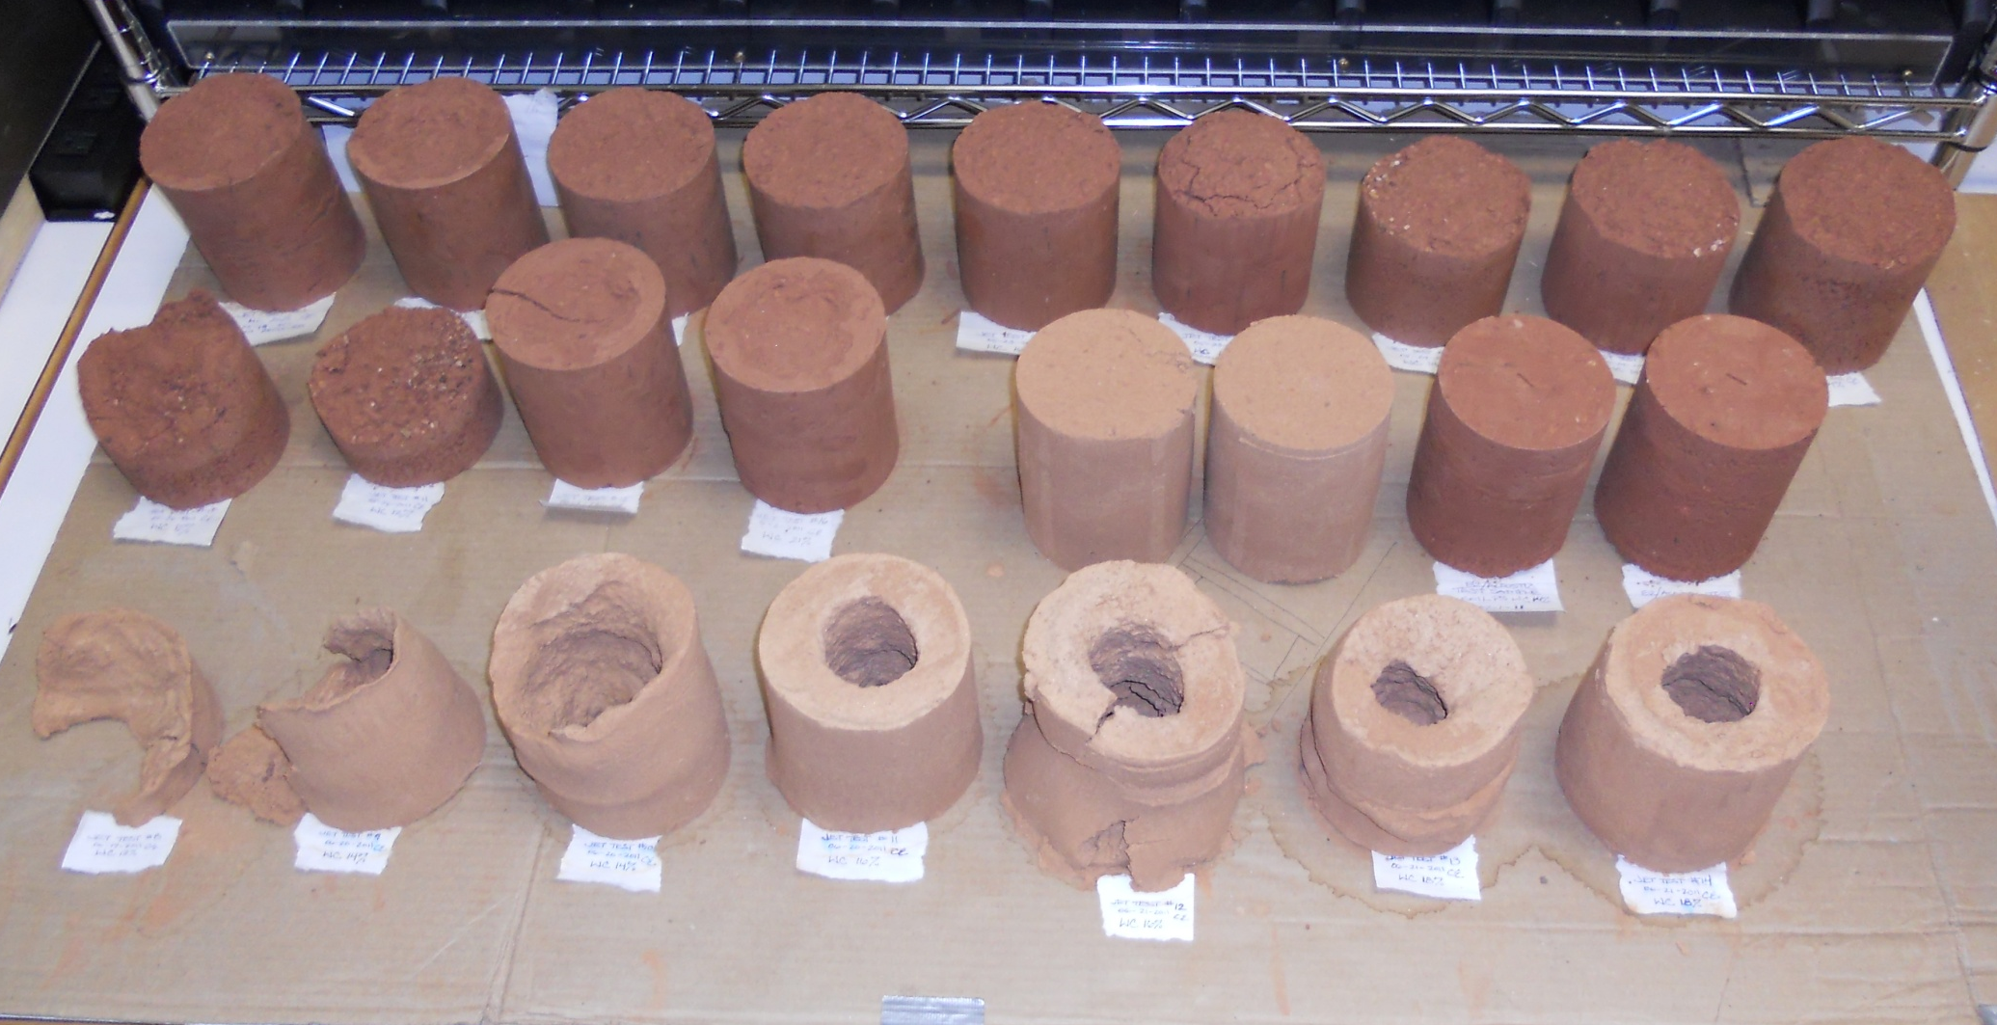
JET Lab Samples
ARS HERU
Notes:
This slide shows how the different samples responded to the laboratory jet erosion test.

Slide 20
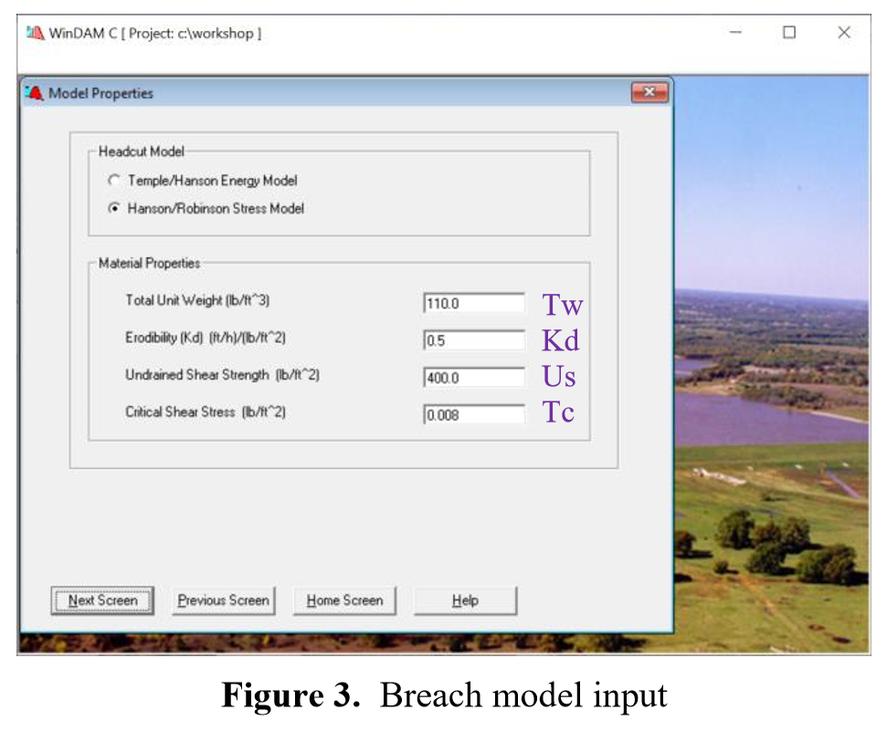

Slide 21
WinDAM Computational Model
Compute hydrodynamics (WinDamSim)
Pre-processing: Generate mesh and dam model (WinDAM)
Post-processing: Extract hydrograph(s) (WinDAM)
Compute dam or spillway erosion (SitesSim)

Slide 22
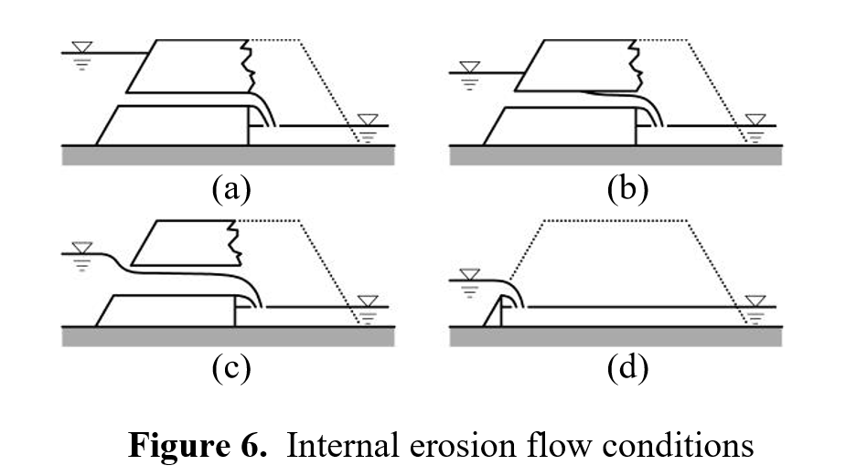
Internal Erosion Flow Conditions

Slide 23
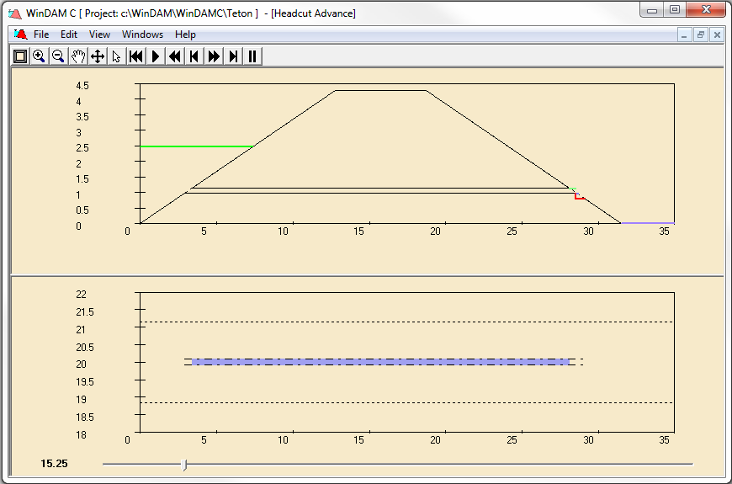
WinDAM Output

Slide 24
Using DAKOTA to drive the Analysis
DAKOTA User Interface
Analysis Model (DAKOTA)
Post-processing: Response Metrics
Pre-processing: Input Parameters
Computational Model (WinDamSim or SitesSim)
WinDAM User Interface

Slide 25
DAKOTA
DAKOTA: Design and Analysis tooKit for Optimization and Terascale Applications - by Sandia National Laboratories
DAKOTA adds value to simulation-based analysis:
Sensitivity - which input parameters affect performance metrics?
Uncertainty (quantification) - how safe, reliable, robust or variable is the system?
Optimization - which design performs best?
Calibration - which models and parameters best match empirical data?
Parameter studies - vary input, how does output change?
All require iterative analysis with the computational model.

Slide 26
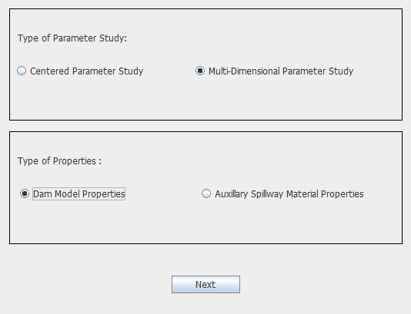
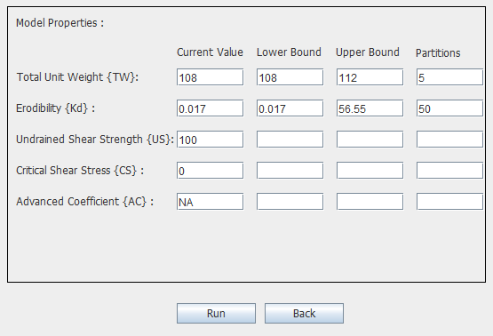
DAKOTA User Interface (for parameter studies)
…
Tw
…
Kd
…
…
Tw
Kd

Slide 27
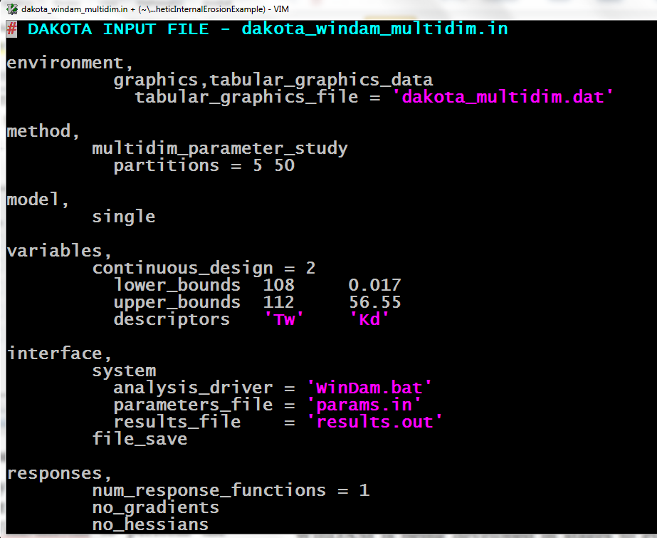
DAKOTA Input File

Slide 28
Using DAKOTA to drive the Analysis
DAKOTA User Interface
Analysis Model (DAKOTA)
Post-processing: Response Metrics
Pre-processing: Input Parameters
Computational Model (WinDamSim)
WinDAM User Interface

Slide 29
Using DAKOTA to drive the Analysis
DAKOTA User Interface
Analysis Model (DAKOTA)
Post-processing: Response Metrics
Pre-processing: Input Parameters
Computational Model (WinDamSim)
WinDAM User Interface

Slide 30
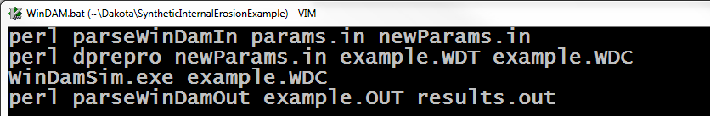
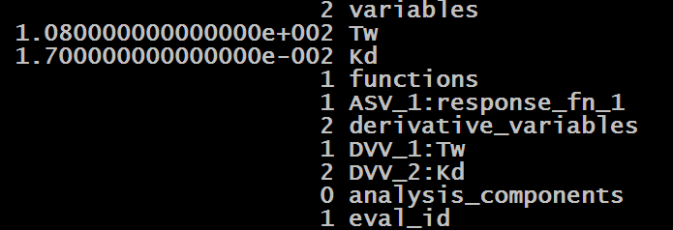
DAKOTA Analysis Driver (WinDam.bat)
params.in
newParams.in
2 variables
0108.0000 Tw
0000.0170 Kd
parseWinDamIn

Slide 31
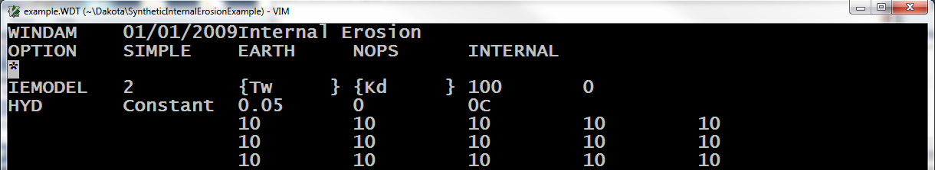
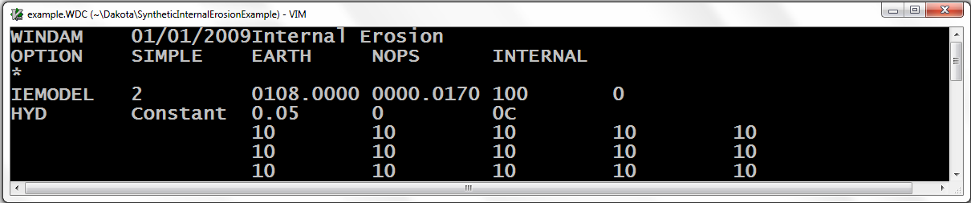
DAKOTA Analysis Driver (WinDam.bat)
example.WDT
example.WDC
dprepro

Slide 32
Using DAKOTA to drive the Analysis
DAKOTA User Interface
Analysis Model (DAKOTA)
Post-processing: Response Metrics
Pre-processing: Input Parameters
Computational Model (WinDamSim)
WinDAM User Interface

Slide 33
DAKOTA Analysis Driver (WinDam.bat)

Slide 34
Using DAKOTA to drive the Analysis
DAKOTA User Interface
Analysis Model (DAKOTA)
Post-processing: Response Metrics
Pre-processing: Input Parameters
Computational Model (WinDamSim)
WinDAM User Interface

Slide 35
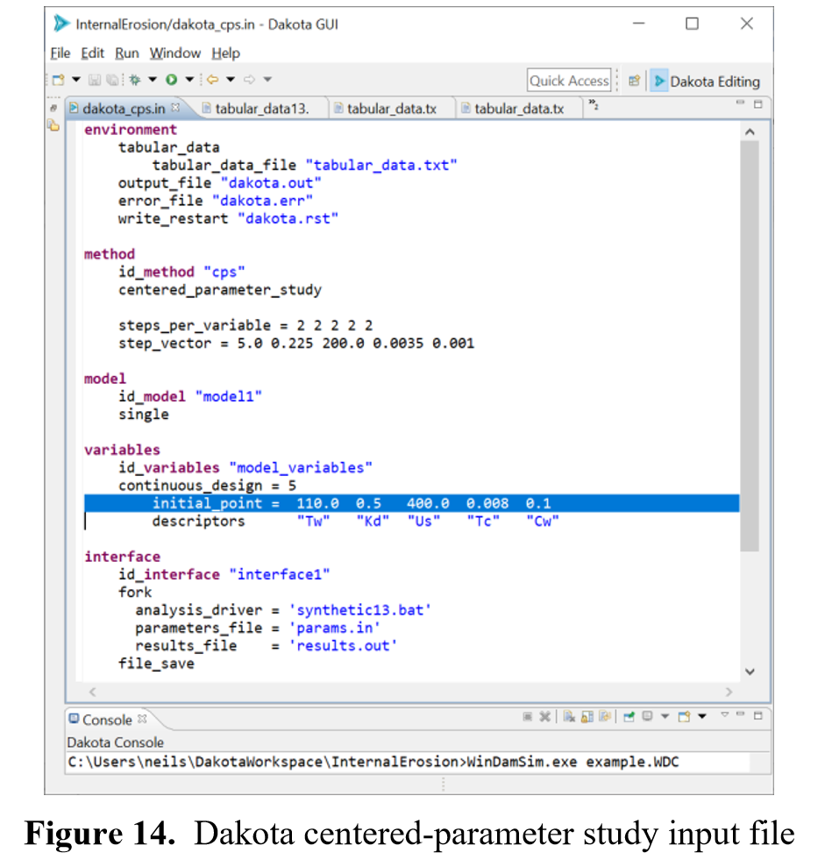
Dakota 6.10 Input Format

Slide 36
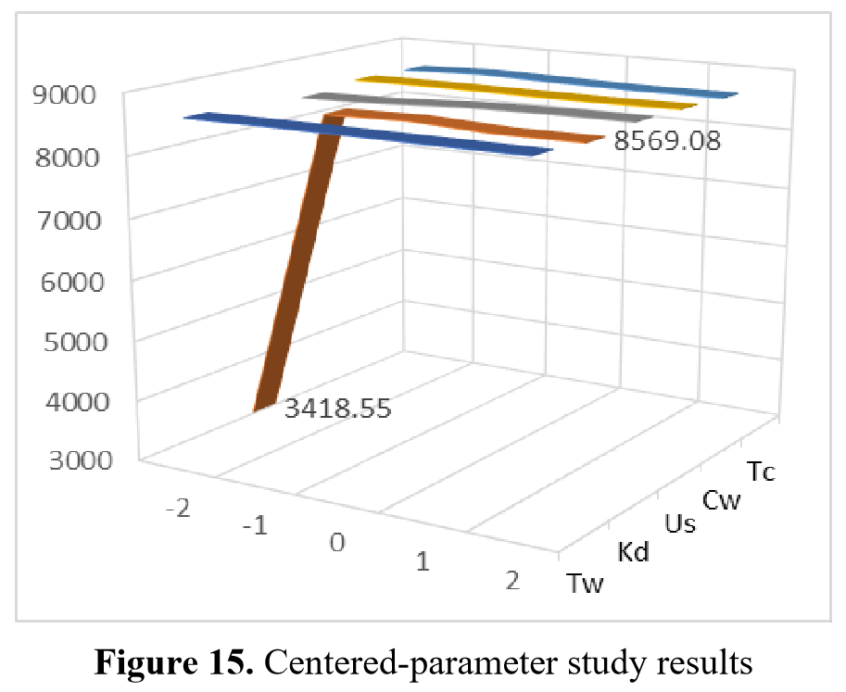
Centered Parameter Study Results

Slide 37
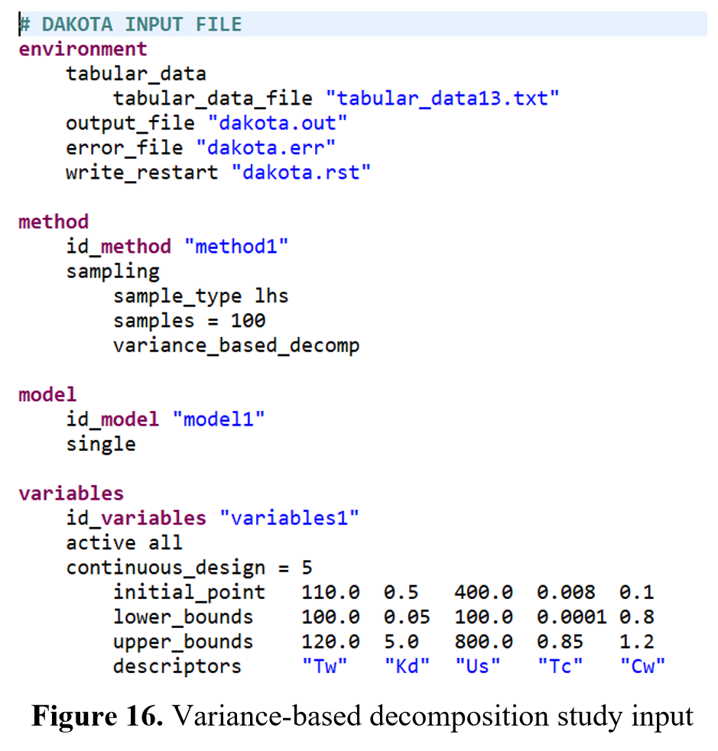

Slide 38
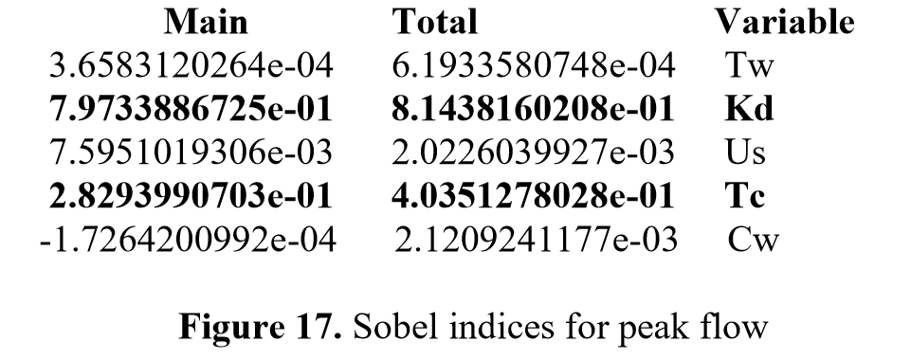
Resulting Sobel Indices

Slide 39
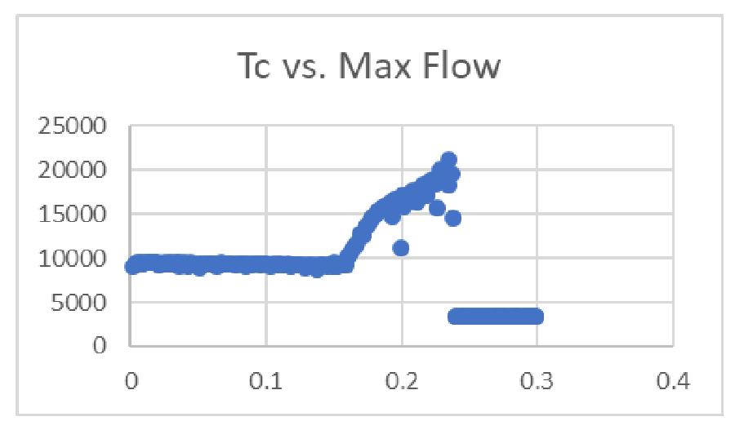

Slide 40
Summary
WinDAM
Provides a framework to combine existing models and develop new models for dam erosion analysis
Dakota
Provides a framework for parameters studies, uncertainty quantification, and sensitivity analysis
Together, they provide a powerful framework for dam safety analysis

Slide 41
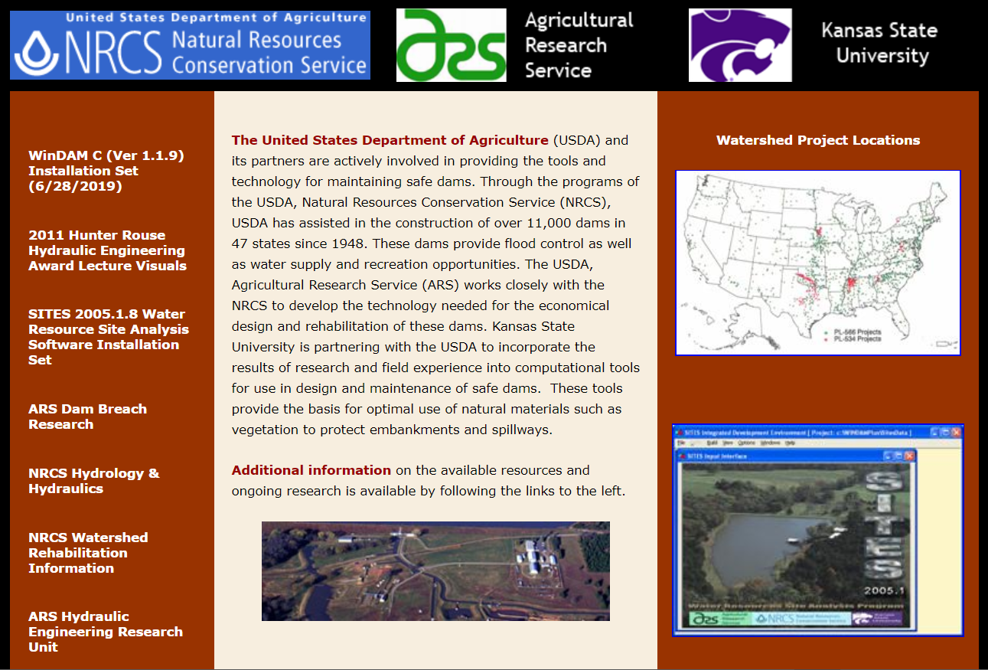
http://www.damsafety.info

Slide 42
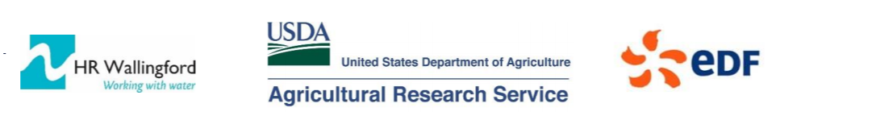

Next Steps
International Internal Erosion Breach Model Performance Evaluation
EMBREA – HR Wallingford (www.dambreach.org)
WinDAM – USDA, KSU (www.damsafety.info)
AREBA – EDF
DL BREACH – Clarkson University
RUPRO – IRSTEA

Slide 43
Next Steps

Slide 44
Questions?

